Slide 1
NTU Testbed for Digital Construction
FU Yuguang (Coordinator)
CHU Jian; YANG Yaowen;
Robert TIONG Lee Kong;
QIAN Shunzhi; KIM Jinwoo;
School of Civil and Environmental Engineering
Nanyang Technological University

Slide 2
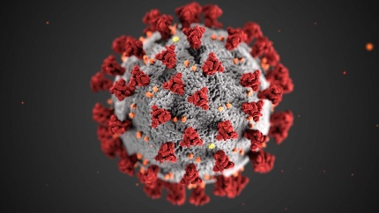

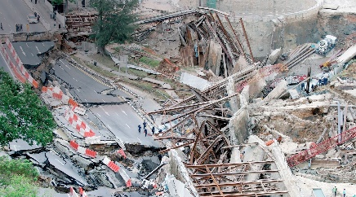
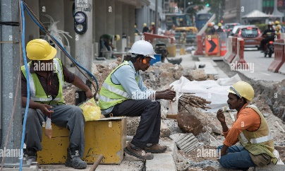
Motivation & Objectives
Covid-19 Pandemics
Labor Shortage
Underground Construction Risks
Low Productivity
Major challenges facing Singapore in Construction (selected)
To transform construction industry during & post pandemic periods
To reduce construction risks and enhance construction safety
To boost construction productivity while reducing manpower usage
To ensure high quality of construction products within given plan/schedule
To provide good start point for life-cycle structural monitoring and management

Slide 3
Digital Construction at NTU
Testbed
NTU testbed for digital construction – from lab to field applications
From construction to life cycle facility management - IoT and AI based solution
Construction digitalization platform for collaboration
Smart materials for automated construction
Mixed reality enabling super workers for construction
Integrated 3D urban digital system and intelligent construction materials
Human psychophysiological responses and behaviours in digital and co-robotic construction
Digitalization
Sensing
Management
Automation
Visualization
Human

Slide 4
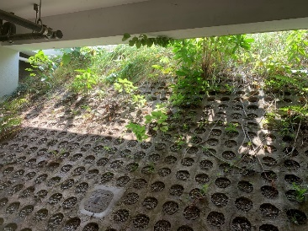
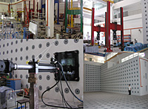
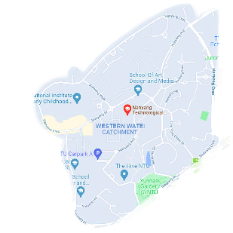

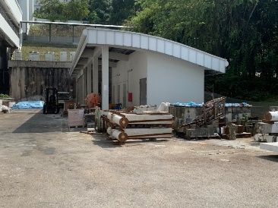
NTU Testbed for Digital Construction
A multi-purpose reconfigurable testbed to support the design, analysis, deployment, and validation of interdisciplinary solutions for digital construction and automation in Singapore.
To test and demonstrate new smart technologies to promote smart construction using:
Internet of things sensors
Digital twin
Virtual/Augmented reality
Swarm robots, etc.
To function as focal point for collaboration in both research and education purpose:
Industry project tests
Data center
Outreach activities, etc.
NTU Testbed
Slope for underground construction demo
NTU Campus
Facilities at Protective Engineering Lab to support testbed operation
Lab & ground space for building construction demo

Slide 5
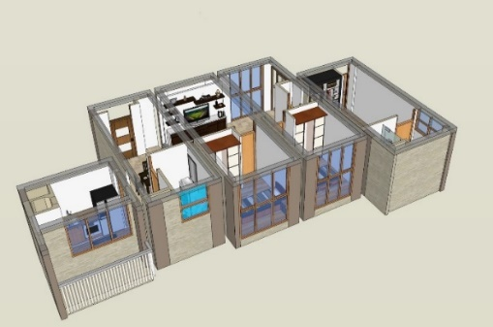
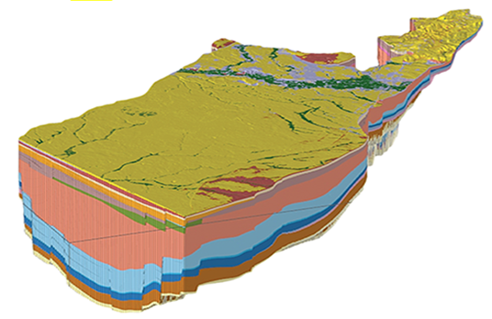
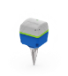
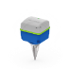
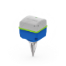
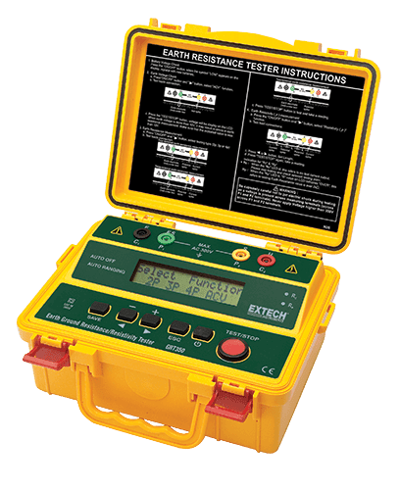
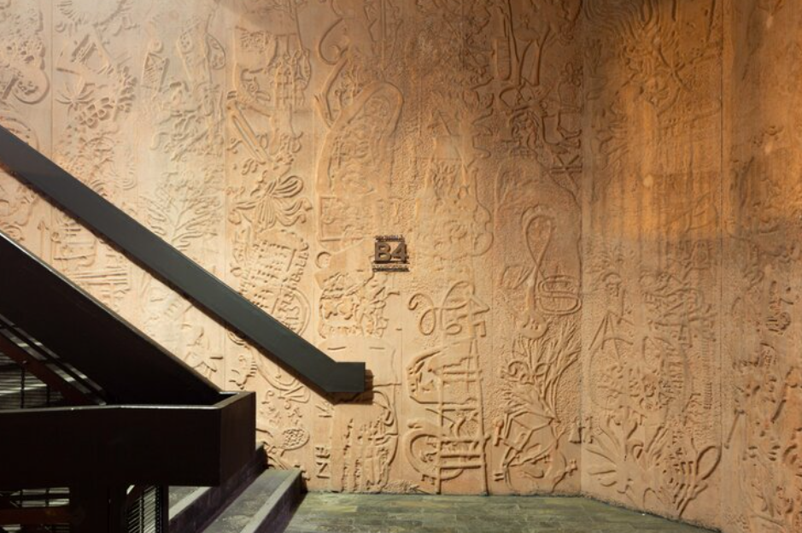
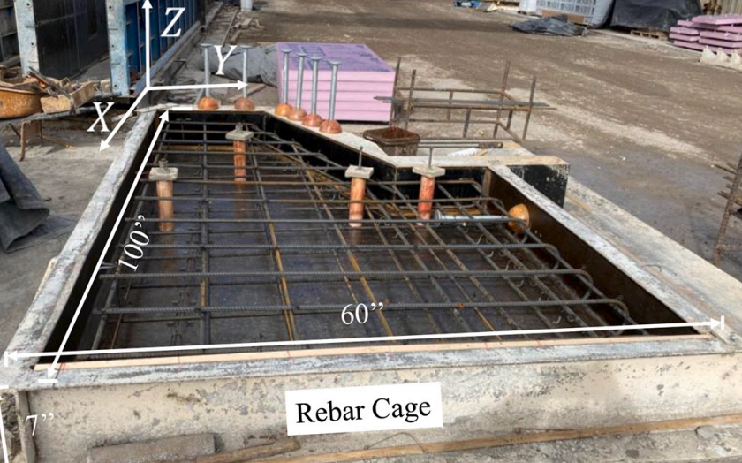
NTU Testbed for Digital Construction
It will hold demonstrations of several research projects as shake-down tests. Some tentative tests are shown below:
Digitalization of Ground Model
PPVC Construction Monitoring
3D Printing of Embossment
AR for Quality Control

Slide 6
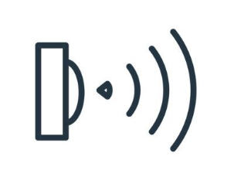
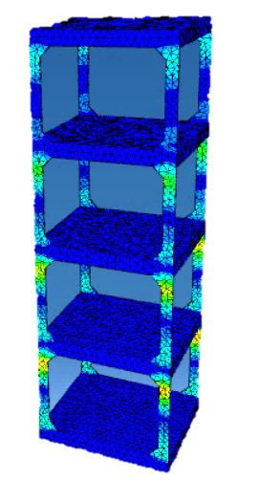


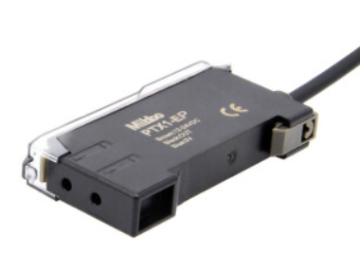
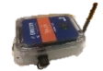






NTU Testbed for Digital Construction
Initial Setup and Plan: sensing, modelling, and testing of a scaled building
FBG sensor for strain
Wireless sensor for acceleration
Wireless data acquisition)
4G/5G modem
Message notification
Internet
Testbed lab model
(reconfigurable)
Testbed digital twin
(in ABAQUS)
Cloud server
( Data storage & analysis)
Data visualization

Slide 7
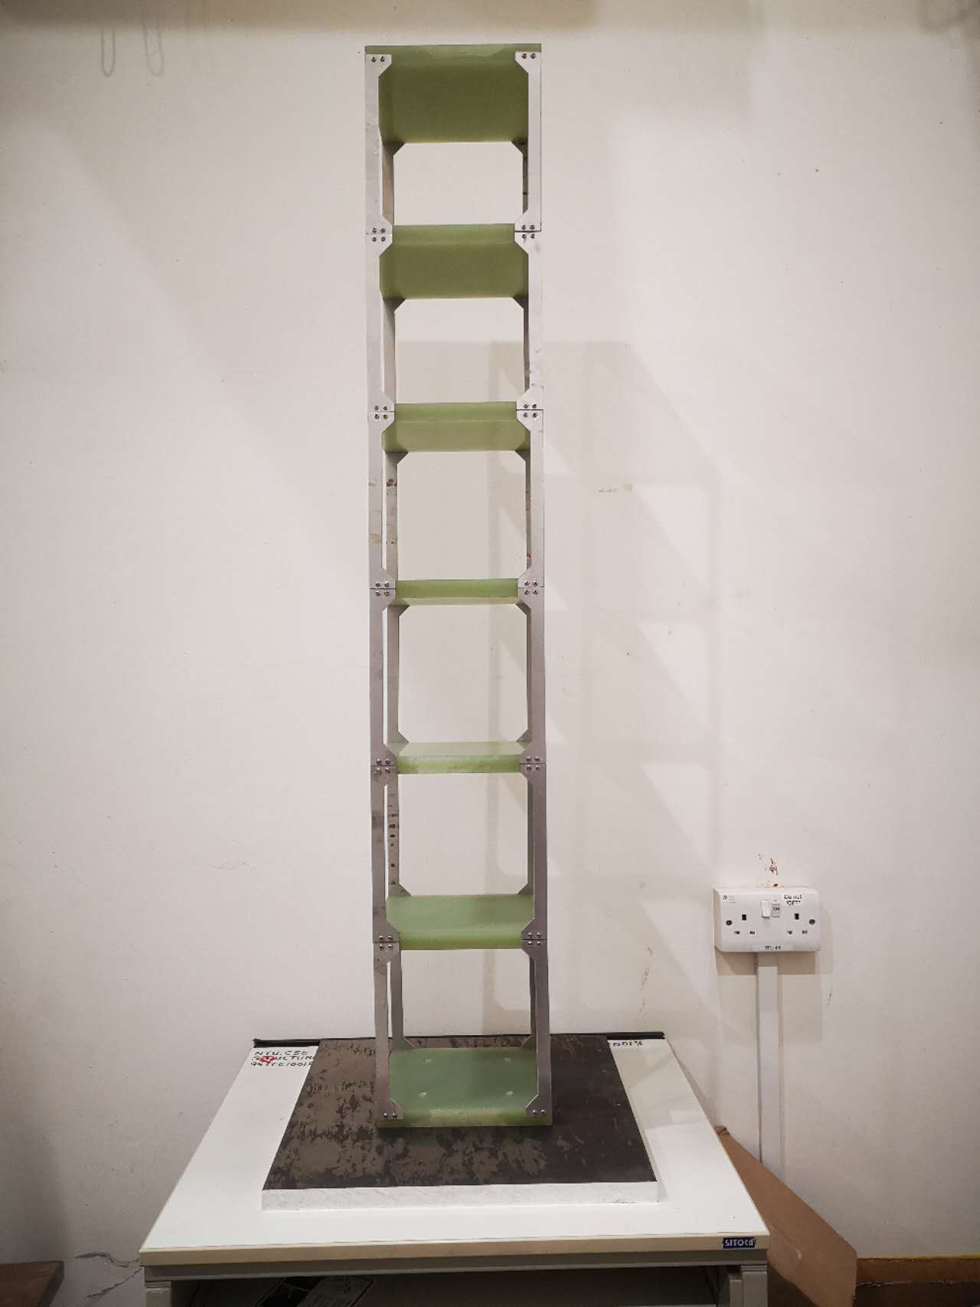
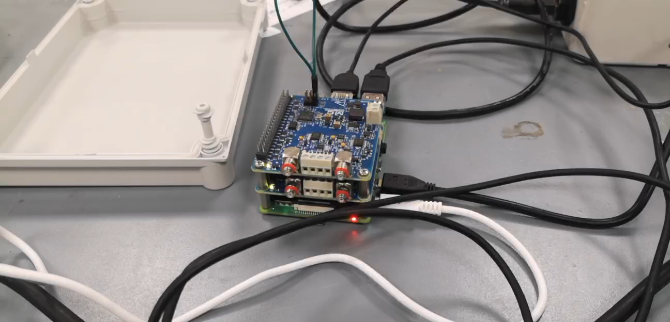
NTU Testbed for Digital Construction
Initial Test Results: near-real-time digital inspection and visualization

Slide 8
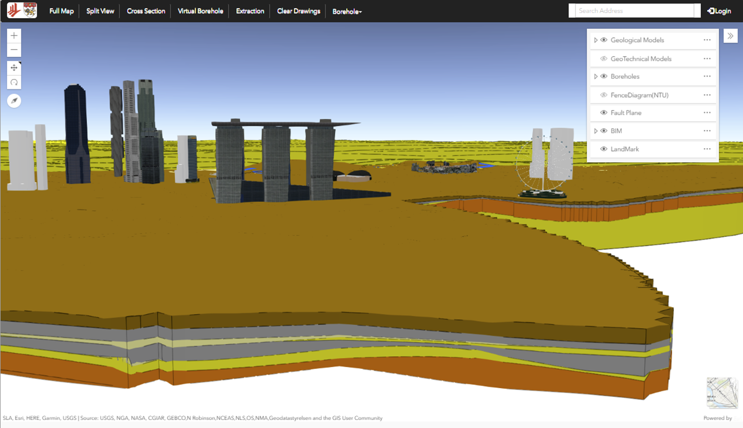
Integrated 3D Urban Digital System
Objectives: to reduce construction risks, reduce manpower and enhance efficiency by digitizing ground model, automating ground monitoring via 3D data processing & visualization, and developing automated construction processes.
A 3D digital system integrating all urban infrastructural data such as BIM, landmarks, 3D geological model, underground utilities, tunnels, pipelines as the basis for digital twin and other digitalization /automation systems.
Development of methods and techniques to enhance the integration and visualization of data such as the use of VR and AR for a virtual excavation experience in different geological formations, or display of monitored ground displacement data with 3D ground model ground supports.

Slide 9
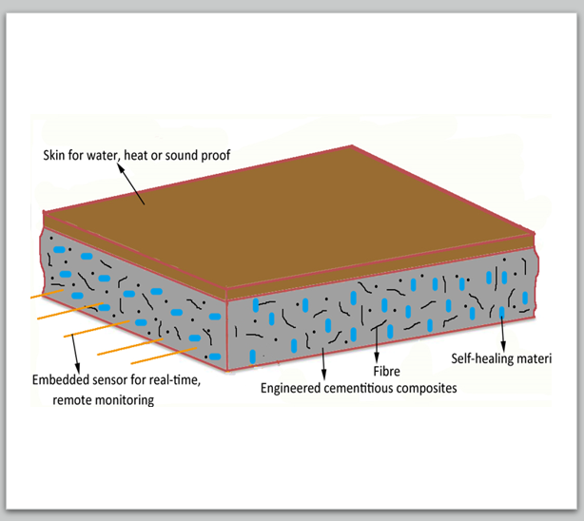
Intelligent Construction Materials
New construction materials having sensing abilities to enable digital construction and monitoring without additional instruments
Develop new materials that have sensing abilities to allow key elements of buildings or infrastructures to be monitored and their performances to be enhanced or improved.
With the ability to sense the responses of the materials, we will be able to make the design more cost-effective as well as more sustainable.

Slide 10
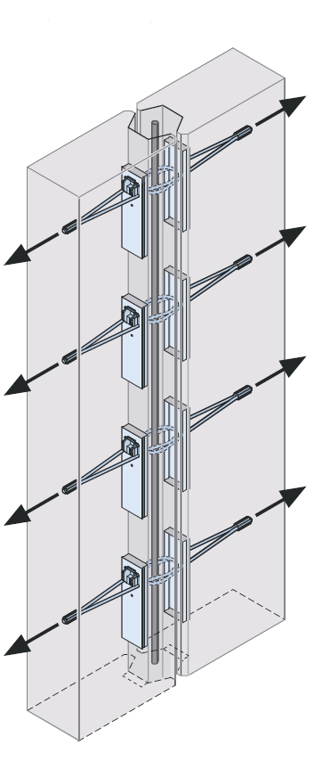
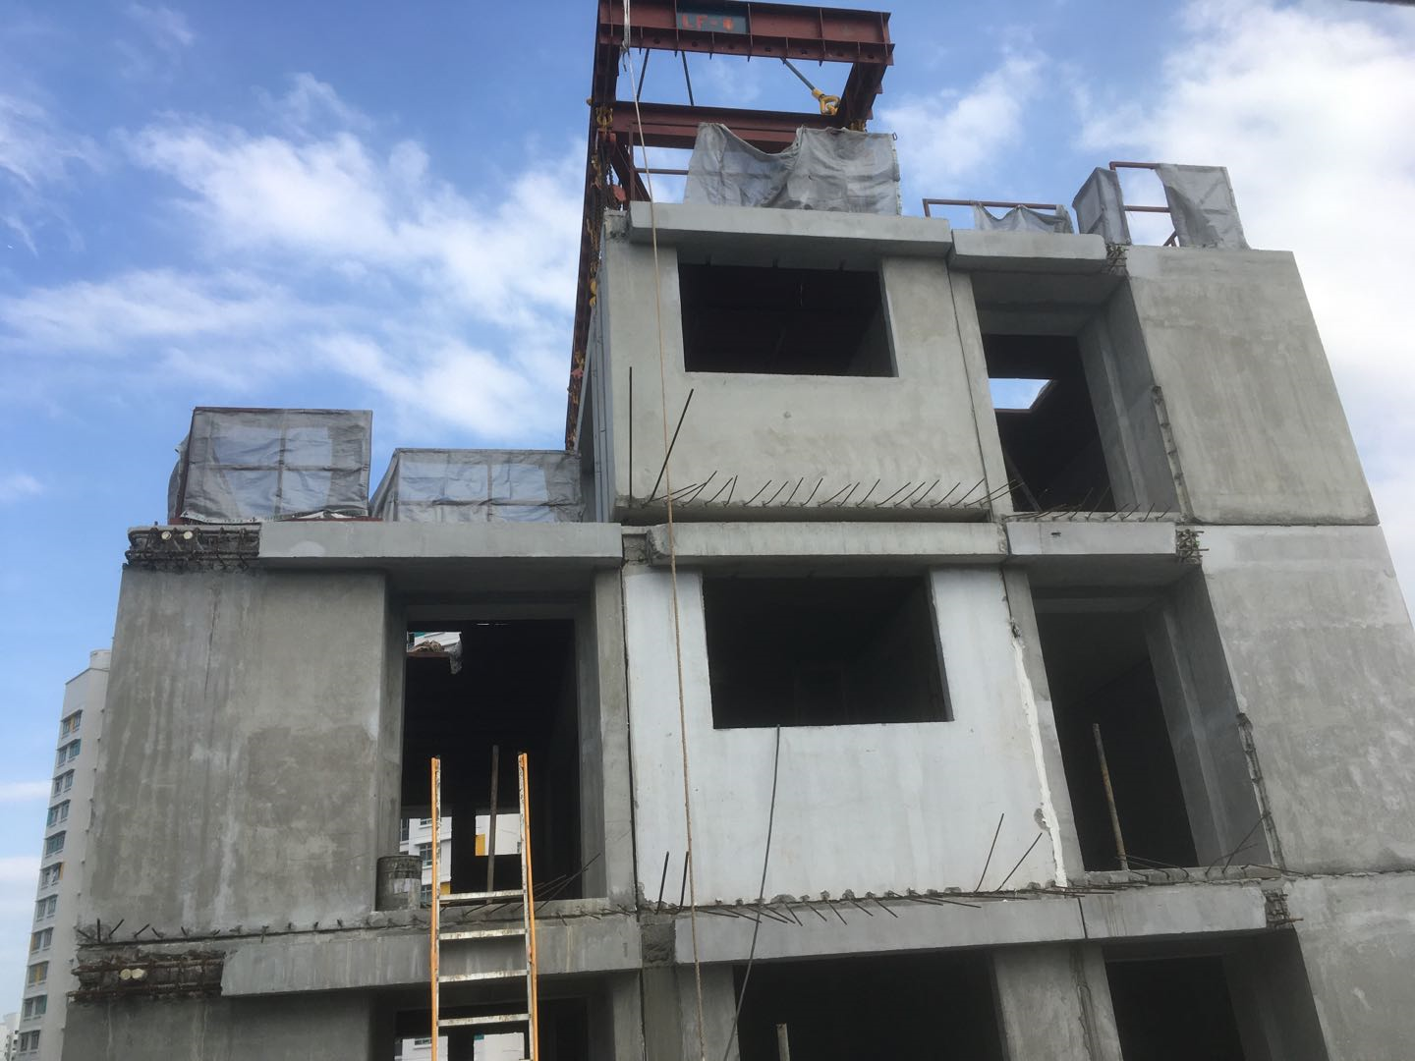
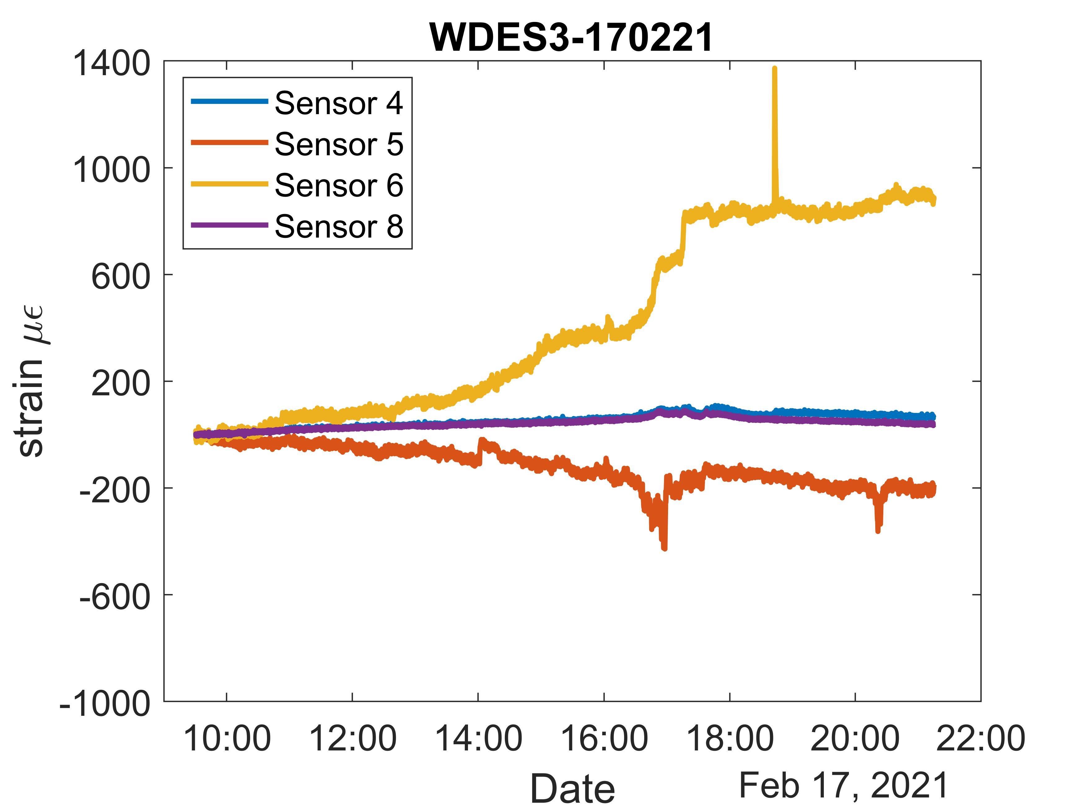
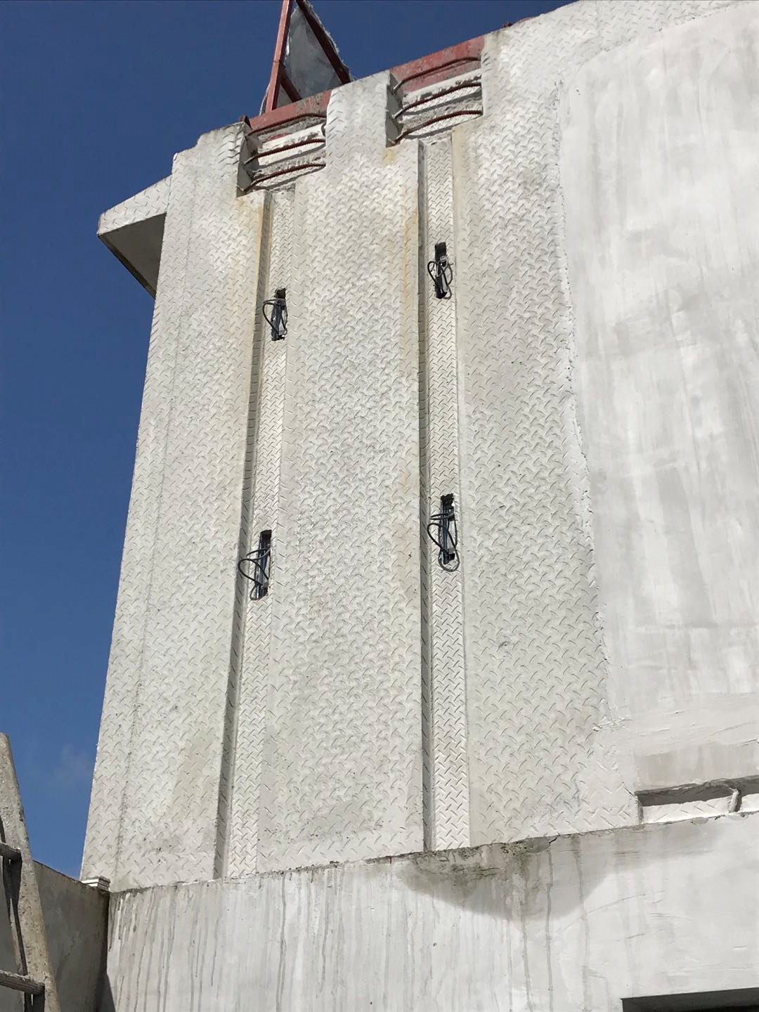
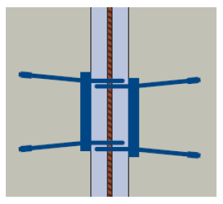
From Construction to Life Cycle Facility Management
- IoT and AI based Solution
PPVC Construction
To consider facility management at design stage
To embedded/integrate sensors during construction, enabling whole life cycle performance monitoring
Wireless IoT sensor network with edge intelligence
To assess PPVC component and connection performance for design optimization
Physics-informed machine learning for data interpretation
To change current practice of periodic maintenance to need-based maintenance
PPVC connection

Slide 11
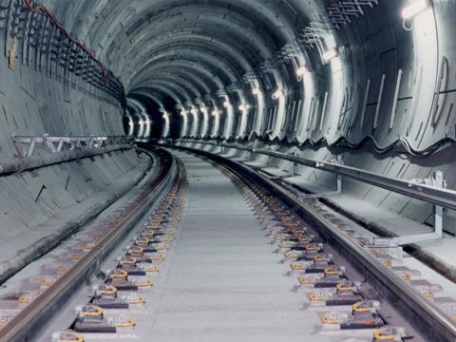
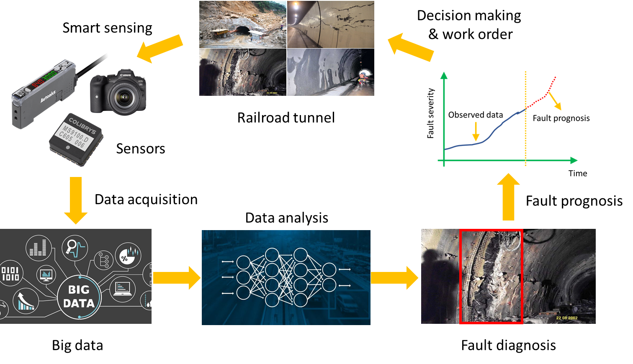
Nov 1 - Nov 30
Dec 1 - Dec 31
Oct 1 - Oct 31
21 days
21 days
22 days
23 days
20 days
22 days
22 days
21 days
Today
From Construction to Life Cycle Facility Management
- IoT and AI based Solution
Transportation network
To detect, diagnose and predict potential faults in high-risk transportation infrastructure
To develop distributed fibre optic sensing system for large scale monitoring of tunnels and bridges
Real time data processing
Fault diagnosis and prediction using AI
23 days
10

Slide 12
Project 1: Integrated DFMA, digital construction and FM with AI and 5G technology for a SEP (Safe, Efficient and Productive) Transformed built environment
Construction Digitalization Platform for Collaboration
Objectives:
an integrated digital platform for construction and FM design will be developed with 8D BIM, 3D information of the buildings and facilities including the geometry information, real-time operational status by IoT sensor network and site and maintenance information.
a deep learning-based AI model will be developed to predict the reliability of the project management for structures, and E&M facilities based on the data collected from IoT sensor and developed BIM platform.
An integrated Mixed-reality functional output with the cloud integration platform will be developed that enables user to integrate work data flows, locate the works correctly and clearly during construction with the best access route and identification.

Slide 13
Construction Digitalization Platform for Collaboration
Project 1: Integrated DFMA, digital construction and FM with AI and 5G technology for a SEP (Safe, Efficient and Productive) Transformed built environment
Deliverables:
To develop an integrated 8D BIM-based platform that can collect and present all related information for management of building construction and facility design and maintenance
To develop a deep learning-based AI models that provides reliable estimation of the site management condition and reliability of the facilities and predict the remaining service life
To provide the optimized maintenance strategy for the buildings and operability of facilities based on the predicted results and improve the efficiency through mixed reality
The proposed integrated digital platform will benefit the industry construction, O&M designs with improved productivity, higher efficiency, better safety and more cost-effective, for a transformed built environment

Slide 14
Project 2 : Digital Collaborative BIM-based cloud platform for Steel Fabricators, Main Contractors, Consultants and Owners
Construction Digitalization Platform for Collaboration
Objective:
A BIM based solution as the central source of information from estimation to engineering to fabrication to project management and payment allows systematic and collaborative approach across the departments.
The result is better decisions, elimination of errors and delivery on time, with easy status monitoring from the dashboard created from the BIM data.
Outcomes:
Identify and develop a digital solution for improving the production workflow in structural steel fabrication and installation
Higher productivity improvement after the system is deployed across the whole production chain, from production shop workers to project managers in plant and in project site
Real time visualization and collaboration by Owners, Consultants, Contractors and Fabricators for SEP (Safe, Efficient and Productive) built environment

Slide 15
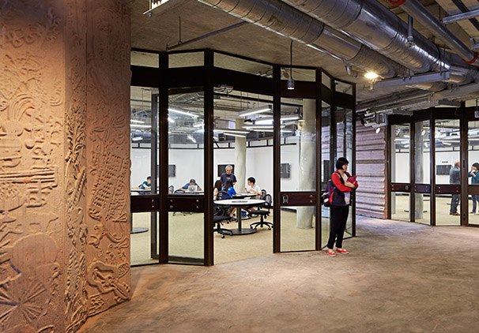
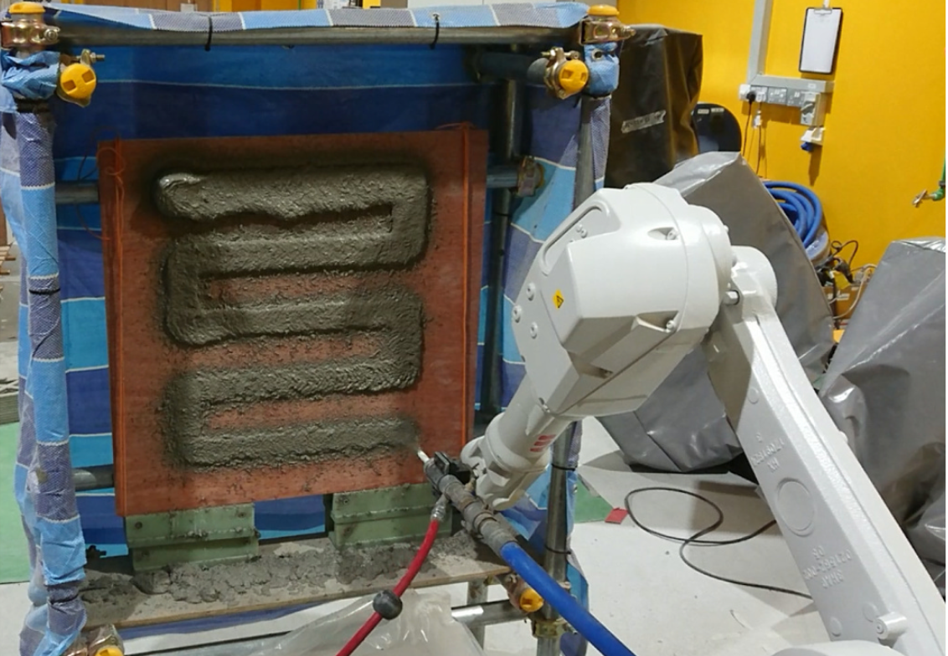
Smart Materials for Automated Construction
Potential for Esthetic/functional surfaces
Currently the embossment was constructed through laborious and costly formwork casting process, which can potentially be achieved by sprayed based automated construction shown right
Automated construction on vertical or overhead surfaces , such as on walls or ceilings
Embossment on the walls of the Hive, NTU
https://www.architectural-review.com/today/learning-hub-in-singapore-by-thomas-heatherwick
(Pattern spray printing by Lu Bing, et al 2021, Automation in Construction, in collaboration with Singapore Centre for 3D Printing)

Slide 16
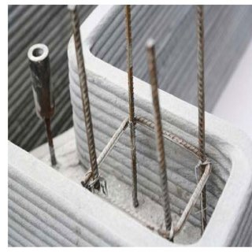
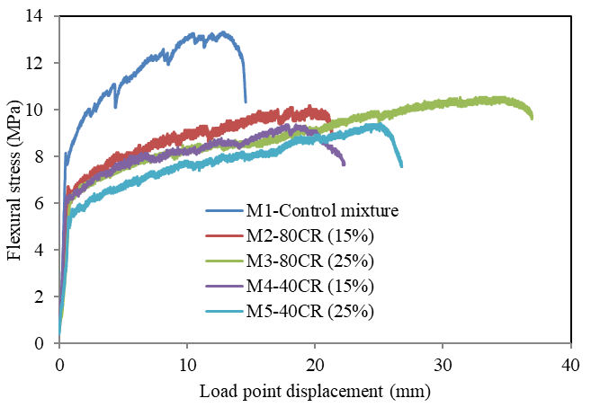
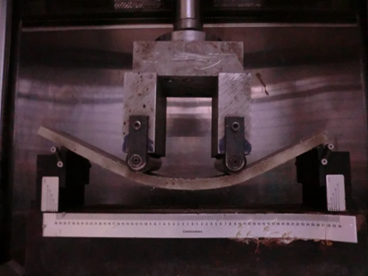
Smart Materials for Automated Construction
Ductile Concrete/ECC to address reinforcement issue in digital construction
With tensile ductility approaching that of steel reinforcement, adoption of ductile concrete/ECC in
digital construction can largely address reinforcement issue and realize full potential of the technology as steel reinforcement may be not necessary in previously lightly-to-moderately reinforced structures
One of the main issue in digital construction: reinforcement placement
Ductile/Bendable Concrete/ECC bending behavior
Zhang, Ma and Qian, 2015, J of ACT
(3D Printed structure, Winsun 2014)

Slide 17

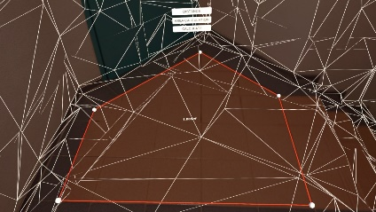

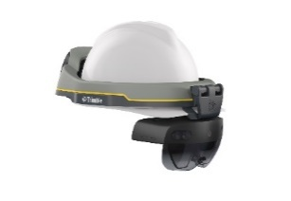
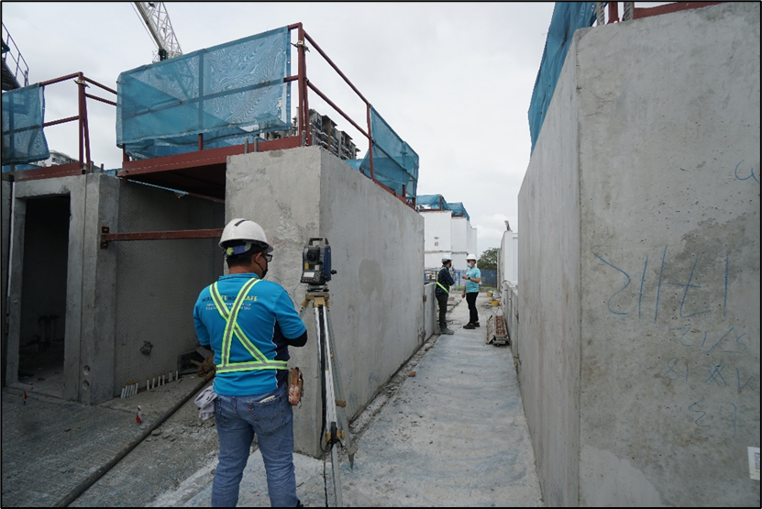

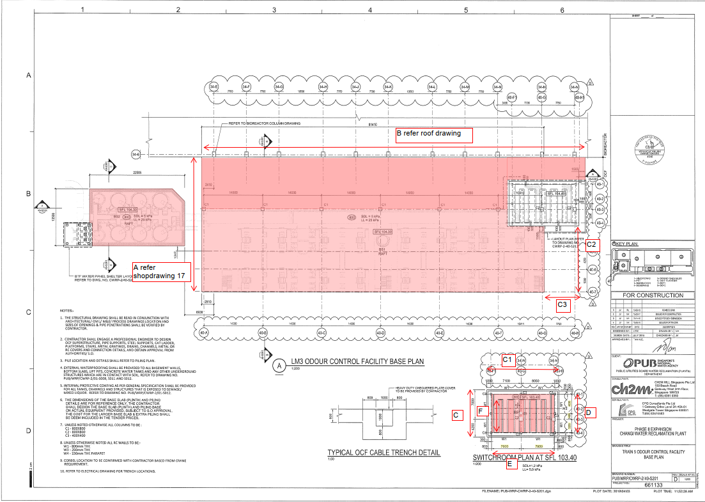
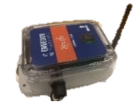
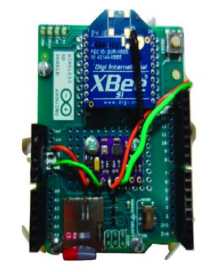
Mixed Reality Enabling Super Workers for Construction
Potential for Construction Inspection
Main objectives
To reduce trade subcontractors and their working time on construction sites
To increase the accuracy and efficiency for construction inspection
To speed up and ensure high quality of PPVC and DfMA process
Main deliverables
A wearable device with user-friendly interface for site engineers' inspection and visualization
An AI-driven data framework with edge/cloud computing technologies for rapid decision making
edge/cloud computing
embedded cameras
Super Head for analyzing.
Super Eyes/Ears for situation awareness
wireless IoT sensors

Slide 18
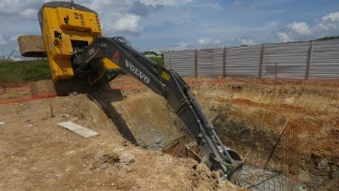
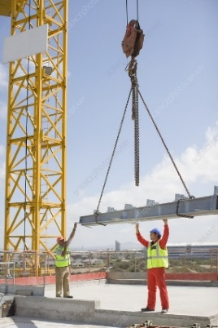
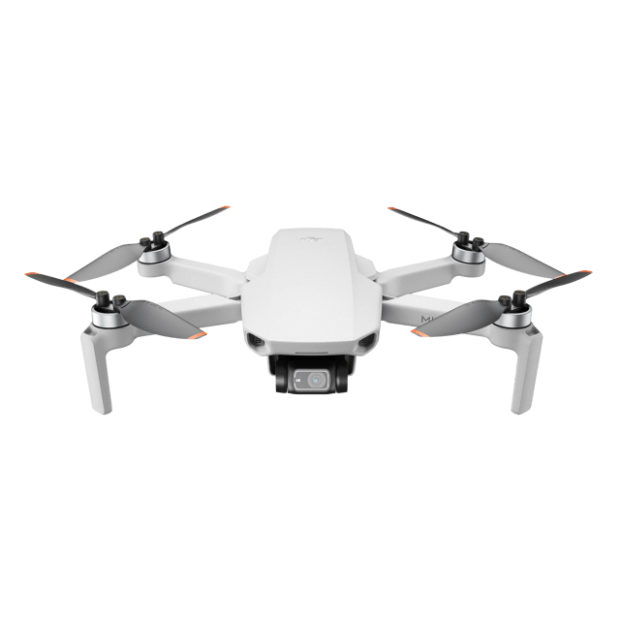
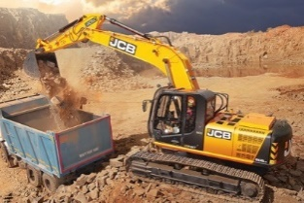
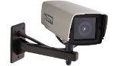
Mixed Reality Enabling Super Workers for Construction
Potential for Construction Operation
Main objectives
To avoid accidents of vehicles and equipment operations on construction sites
To facilitate cooperations between multiple vehicles and cranes
To reduce the required manpower during operation (e.g., banksman)
Main deliverables
A wearable device for operators (e.g., crane operator) to provide 360 view and smooth communication
An AI-driven data framework for early warning of dangerous actions and operation suggestions
avoid accident
edge/cloud computing
embedded cameras
facilitate collaboration
Super Head for analyzing.
Super Eyes/Ears for situation awareness
Surveillance Cameras
without banksman

Slide 19
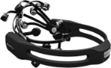
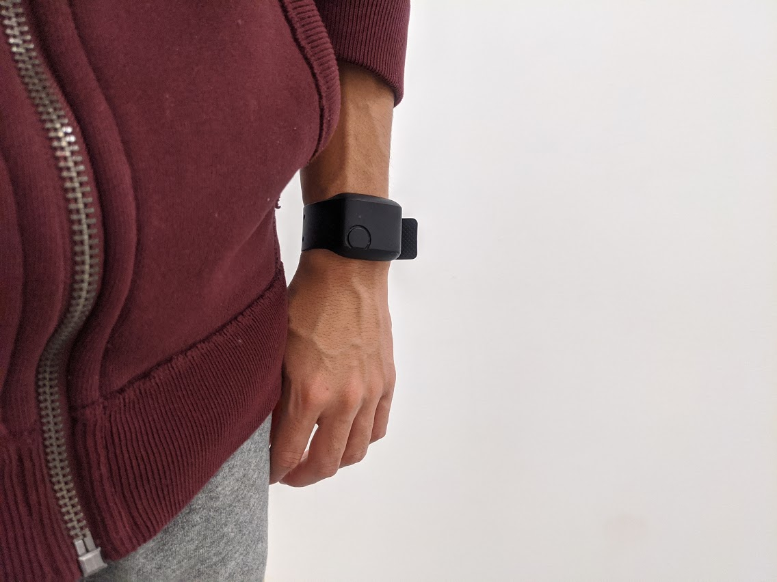








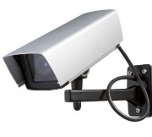
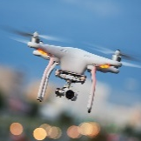







Human Psychophysiological Responses and Behaviours in Digital and Co-robotic Construction
Q: How to build a “human-friendly” construction industry while being productive and safe?
AI-assisted Digital Monitoring
Human Factors Capturing
Analyses & Understanding
Reading: Bio-signals
Psychophysiological
Performance Tracking
Physical
Mental
Emotional
Productivity
Safety
Quality
Watching: Behaviours
Behavioural
Theories & Statistical Learning
Human-friendly Intervention (scheduling, worker training, layout, etc.)
Notes:
Motivation: “human-friendly” construction industry
Objective: understand how human feel, respond to, and behave in new digital and co-robotic construction as well as conventional working environments.
Method:
Digital monitoring of human bio-signals and behaviours using AI-assisted wearables and intelligent camera systems.
Capturing human psychophysiological responses like physical, mental, and emotional; and working behaviours like whether they are working or not, or they are taking risky behaviours.
Performance tracking in terms of productivity, safety, and quality; and understanding why the performance is low using existing construction theories and statistical learning and analyses.

Slide 20







Example: Heat Strain, Working Behaviours, and Work Performance
Heat Strain
HSI
Future status
Current status
Time
Time
Human DB
Project DB
Work Performance, Schedule, Site-layout, etc.
Working Behaviours (e.g., activity types and poses)
Notes:
Bio-signals: temperature, sweatness, heart rate → heat strain
Video: behaviors (activity types and poses)
Findings: the relationships between human factors and project factors (e.g., work performance/schedule/site-layout); e.g., why the productivity is low?
Suggestions: cooling equipment, work pace/re-scheduling, worker training, site-layout adjustment, etc.

Slide 21
Industry Partners
Woh Hup Construction
Kajima
TeamBuild
United Tech
China Railway Engineering Equipment Group Co., Ltd. Singapore
One GIS Pte Ltd
Kimly Construction
China Construction
Trimble Solutions SEA Pte Ltd
Graphisoft

Slide 22





Testbed Collaboration with UC Berkeley
Cyber-Physical Hybrid Lab for enhanced research collaboration and training
NTU An EDS/Sky Factory/Robotic collection
Cyber testbed
UCB Center for Smart Infrastructure
Construction Robotics Lab
Ken Goldberg Lab
SinBerBEST to SinBerCREST

